Slide 1
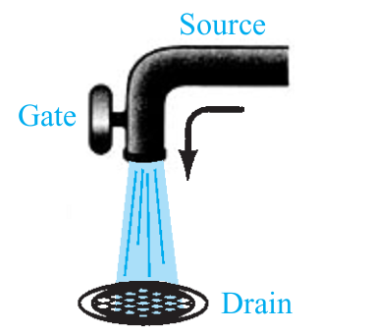

CO2015 Field Effect Transistor

Slide 2
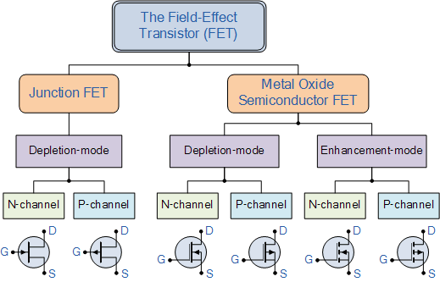
Field-Effect Transistor (FET)

Slide 3
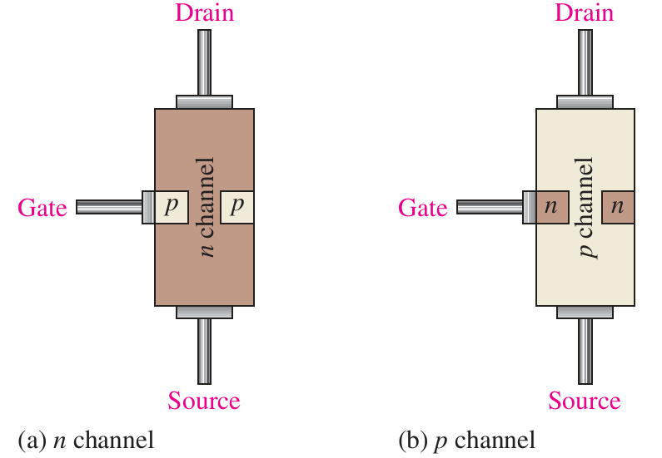
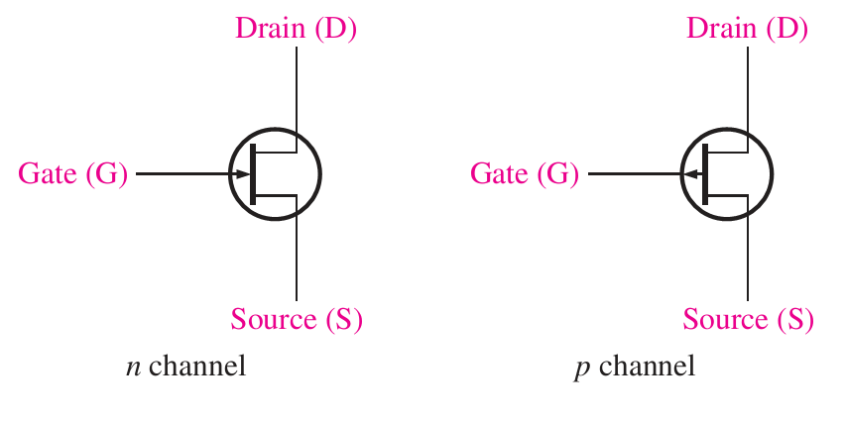
JFET

Slide 4
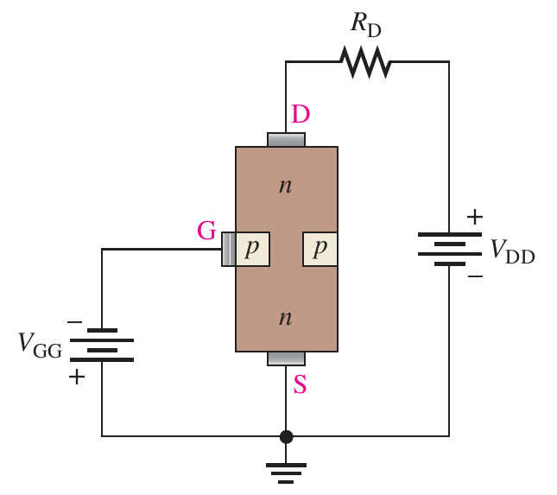
JFET Operations
G and S always in reversed-bias:
V_{GS} is negative: Depletion area is increased → Resistance between D and S is increased
V_{GS} is increased (to Zero): Depletion area is decreased → Resistance between D and S is decreased
G and S is in forward-bias:
JFET likes a resistor

Slide 5
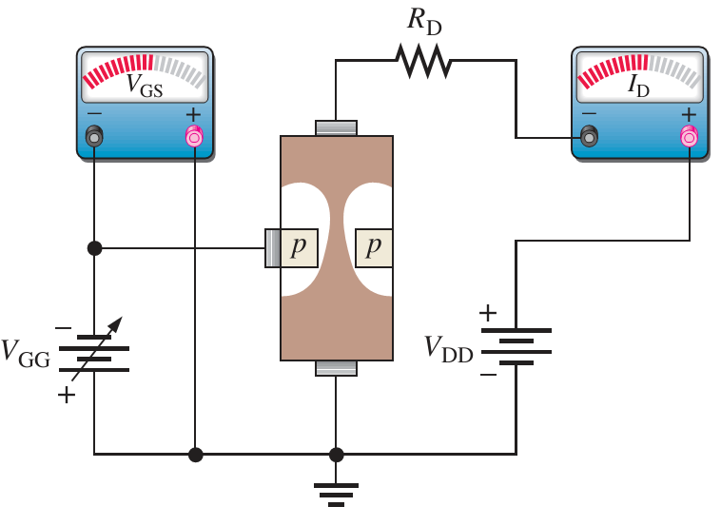
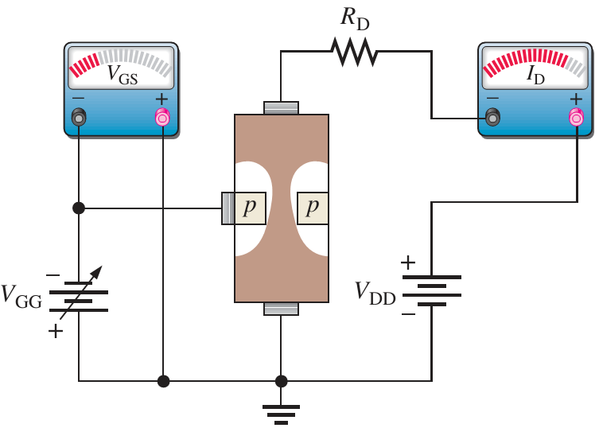
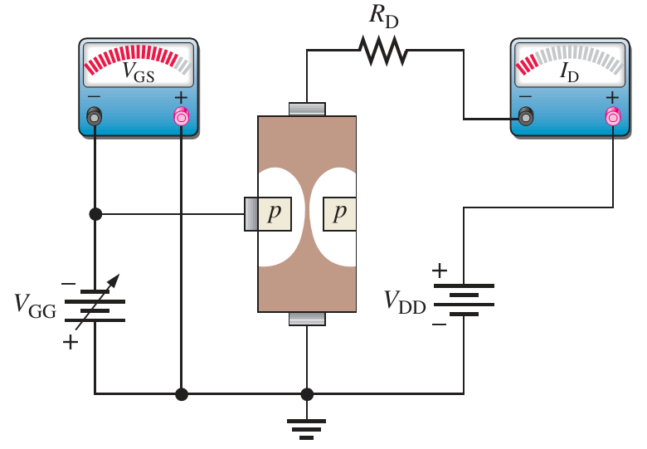
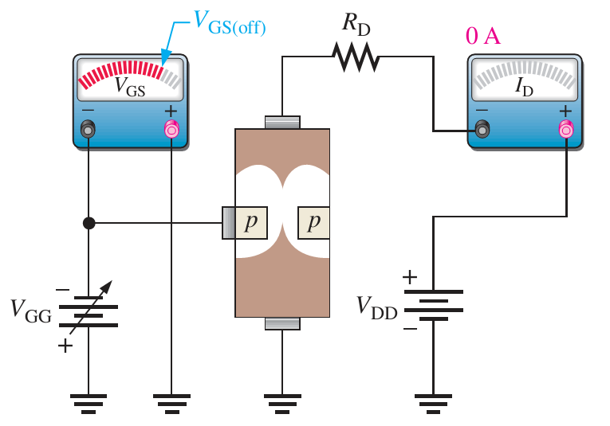
JFET Operations

Slide 6
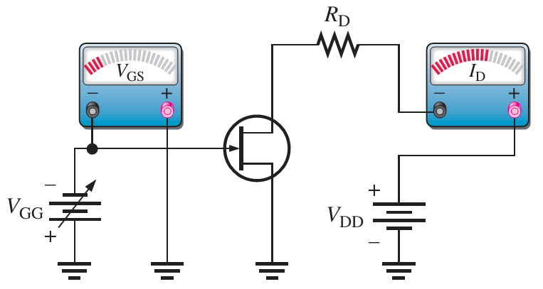
JFET Characteristics
JFET n-channel has three operation modes when V_{DS} >0
A. V_{GS} = 0, JFET is in saturation, I_{D}=Max
B. V_{GS} < 0, JFET is in linear status, I_{D}↓
C. V_{GS} =-V_{off}, JFET is OFF, I_{D}=0

Slide 7
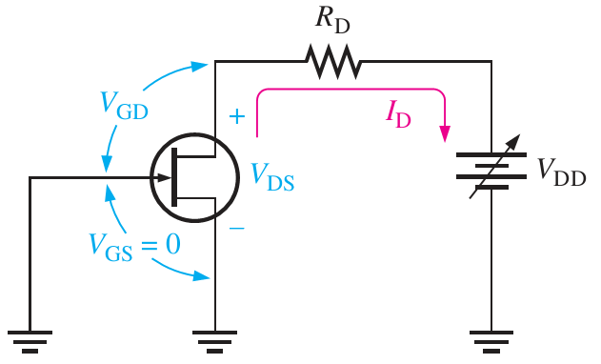
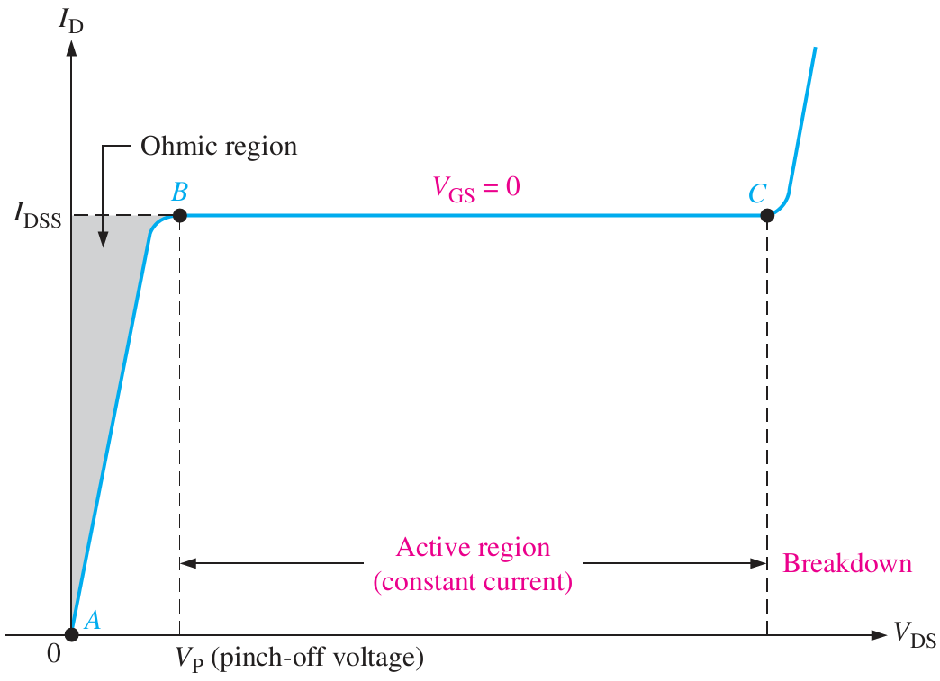
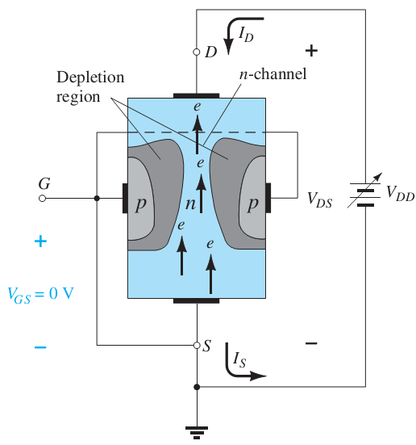
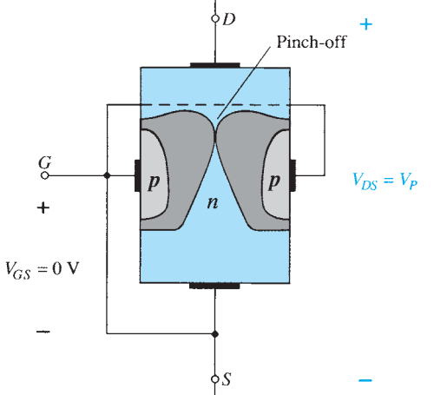
JFET Saturation Mode
V_{GS} = 0V, V_{DD} is increased slowly
Linear region A-B: V_{DS} = RI_{D}
Saturation region B-C: I_{D} is constant
Pinch off region due to the increase of depletion area.

Slide 8
Cut-off State
Reversed-bias: 0 < V_{GS} < V_{GS(off)}
Depletion area is increased → closer to Pinch-off state

Slide 9
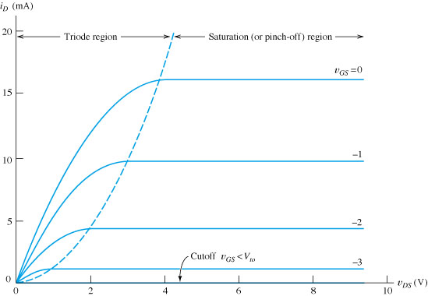
JFET Characteristic

Slide 10
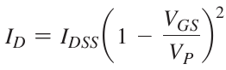
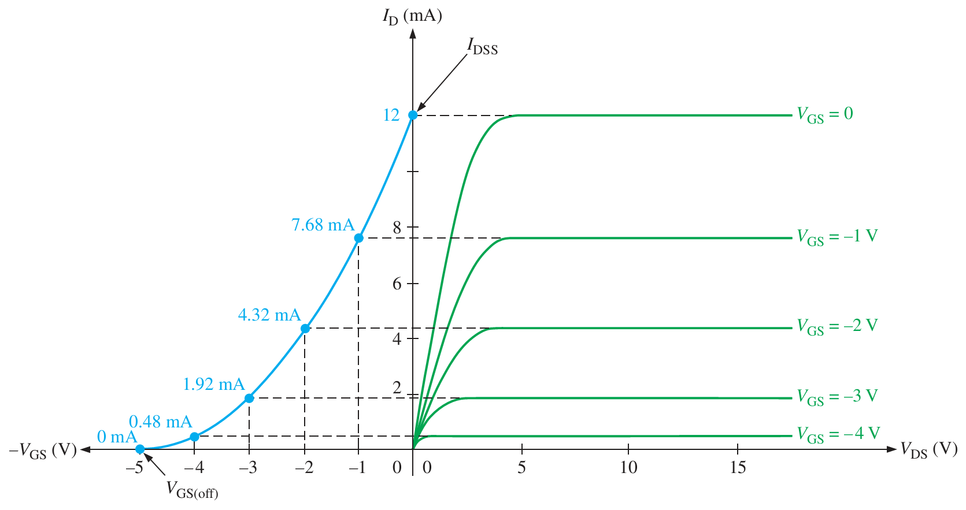
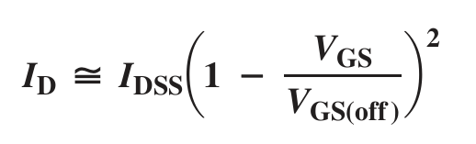
JFET Transfer Curve

Slide 11
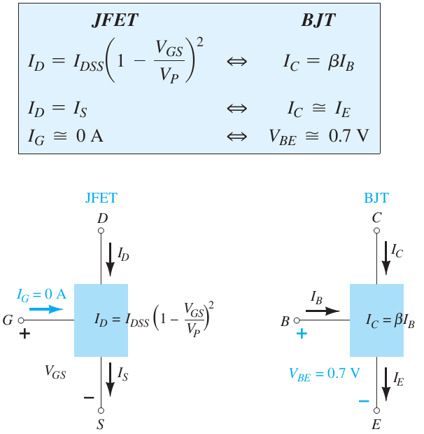
JFET vs. BJT

Slide 12
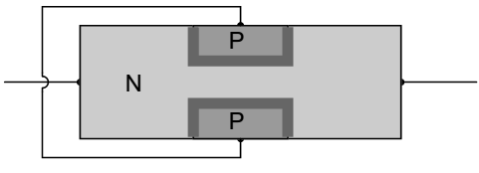
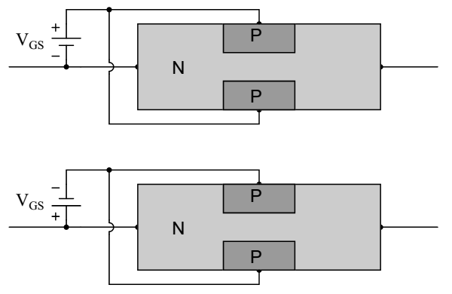
Example
JFET normal state
Determine depletion area in follows:

Slide 13
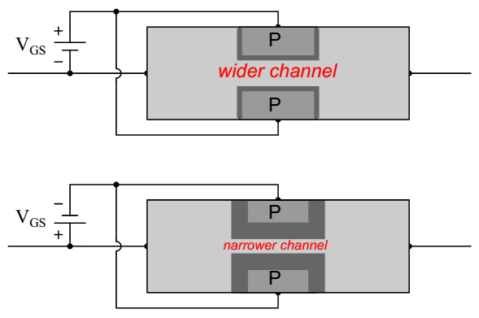
Answer
First figure: Forward-bias → depletion area is wider
Second figure: Inverse-bias → depletion area is narrower

Slide 14
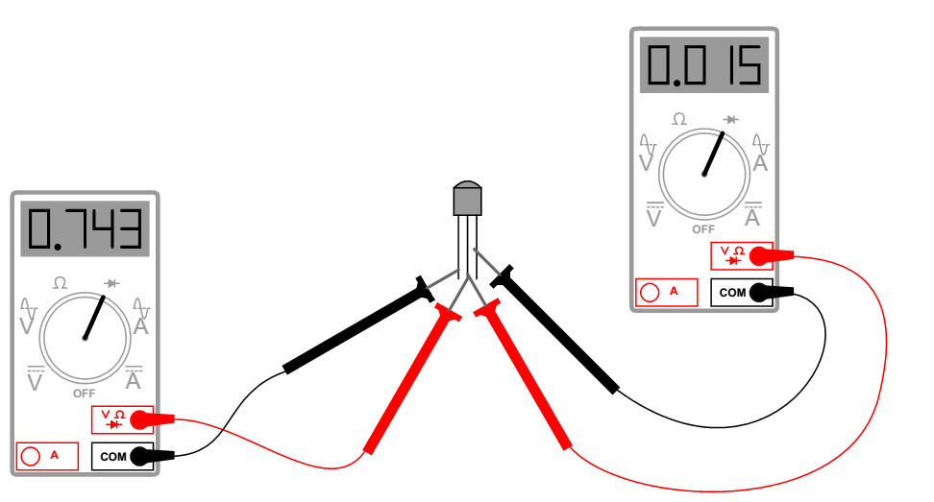
Example
Determine JFET pins
Notes:
The left-most terminal on this JFET is the gate, and the other two are source and drain. This is a P-channel JFET

Slide 15
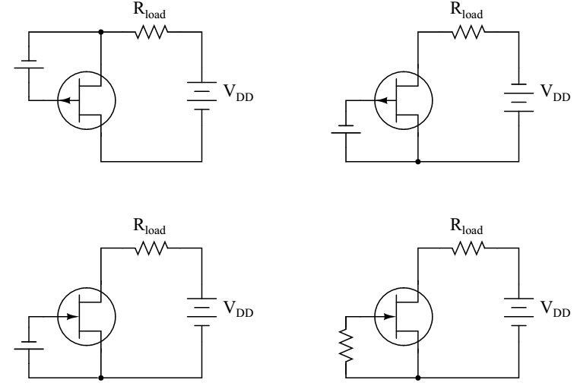
Example
Determine the correct type (p-channel or n-channel) of the following JFETs and its state (ON or OFF)

Slide 16
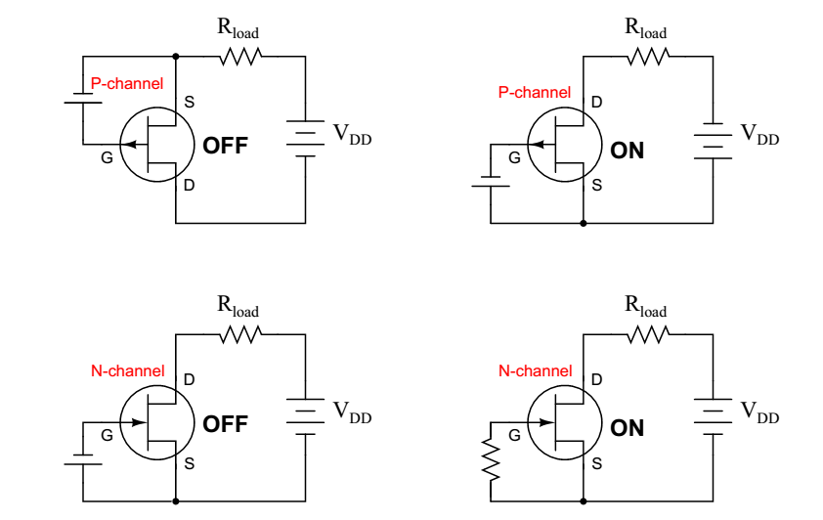
Answer

Slide 17
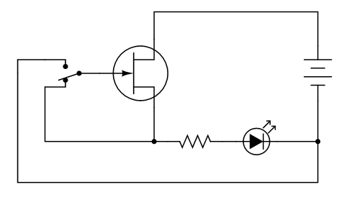
Example
Determine the LED status (ON or OFF) regarding each position of switch.

Slide 18
Answer
ON State: V_{GS} = 0V (Saturation mode)
Next: OFF state: Inversed-bias with very negative V_{GS}

Slide 19
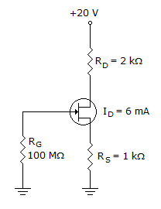
Example
Determine V_{DS}
Determine V_{S}

Slide 20
Answer
V_{DS} = V_{DD} – I_{D}R_{D} – I_{S}R_{S}

Slide 21
Exercise
Determine
Notes:
Example 7.2 (page 429 Textbook 11edt)

Slide 22
Exercise
Determine
Notes:
Example 7.2 (page 429 Textbook 11edt)

Slide 23
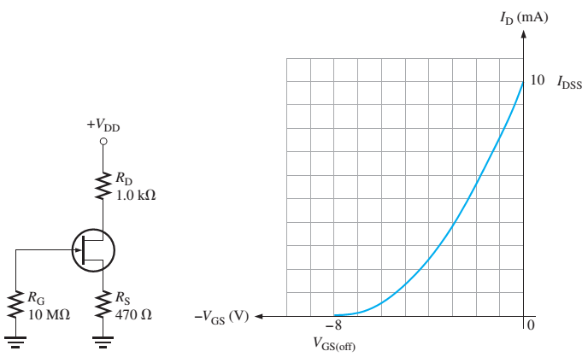
Example
Determine V_{GS} and I_{D}

Slide 24
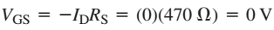
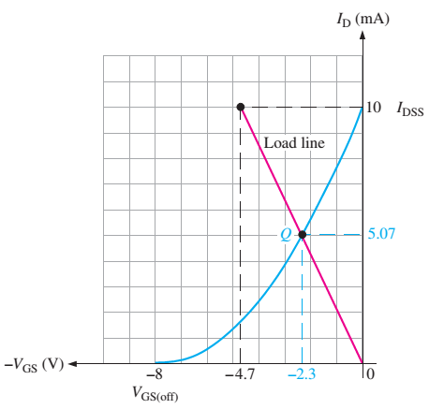
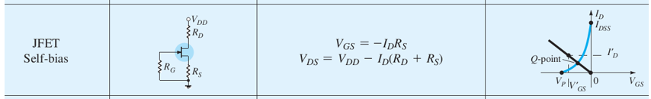
Answer
Determine the Load line
I_{D} = 0
I_{D} = I_{DSS}
Q is the intersection point of the load line & transfer curve.
I_{D} = 5.07 mA
V_{GS} = -2.3V

Slide 25
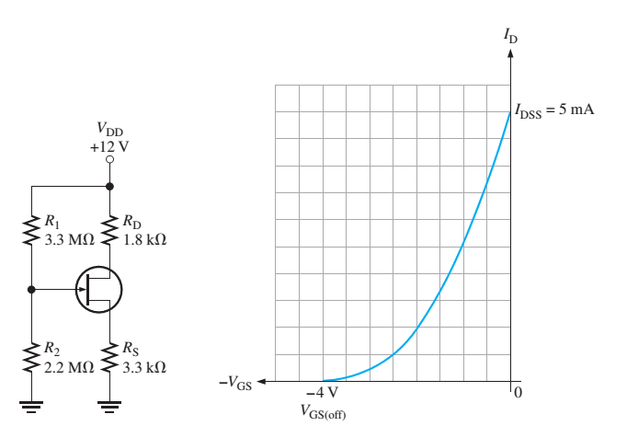
Home Work
Determine V_{GS} and V_{DS} for the given JFET, where
I_{DSS} = 5mA and V_{GS(off)} = -4V

Slide 26
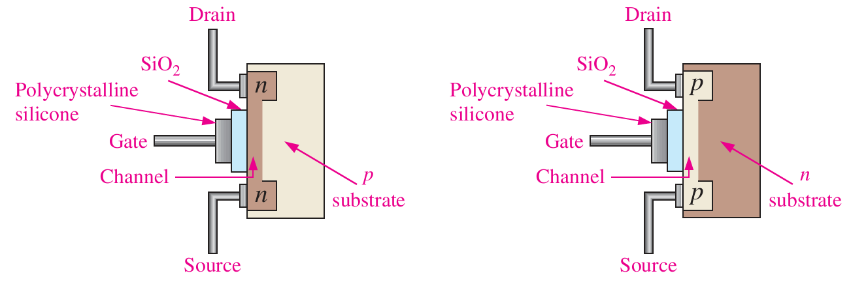
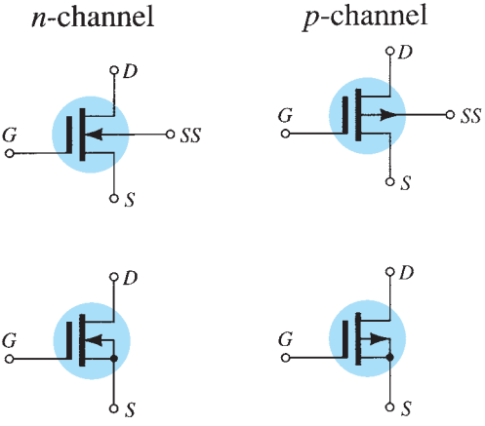
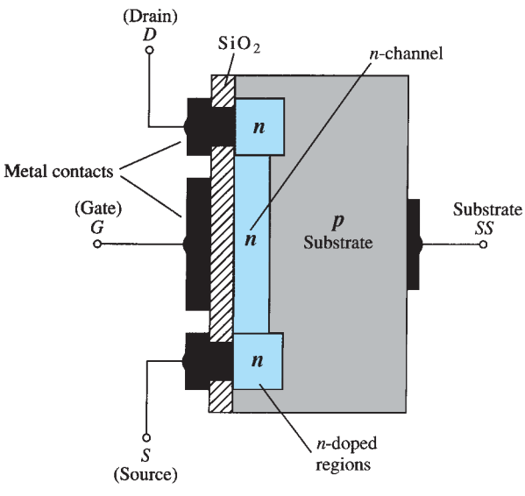
D-MOSFET

Slide 27
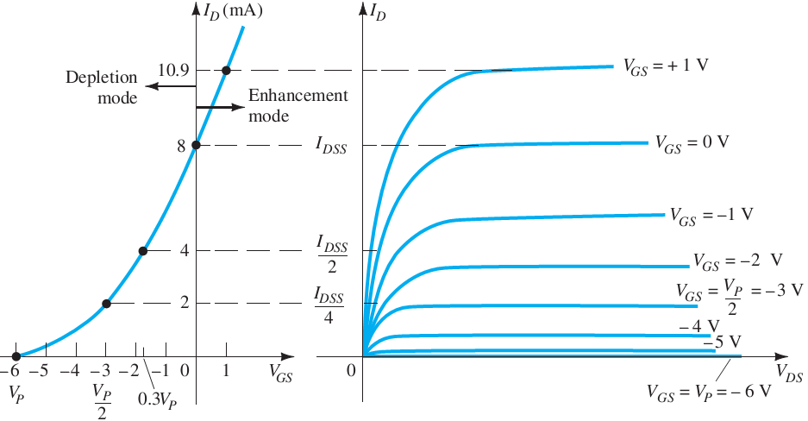
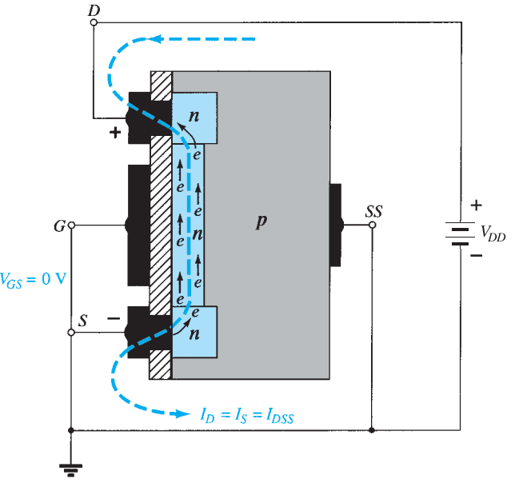
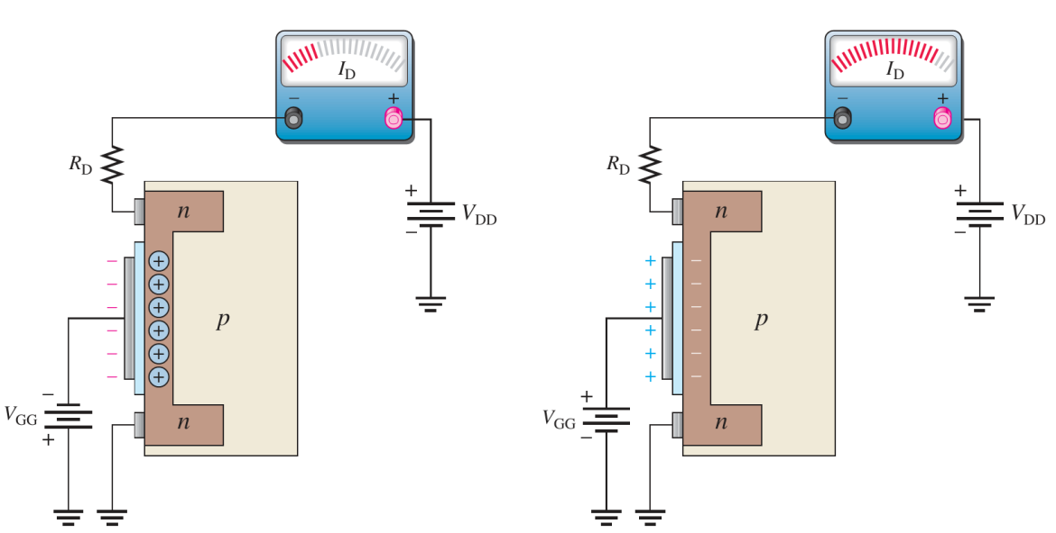
D-MOSFET Operations (N type)

Slide 28
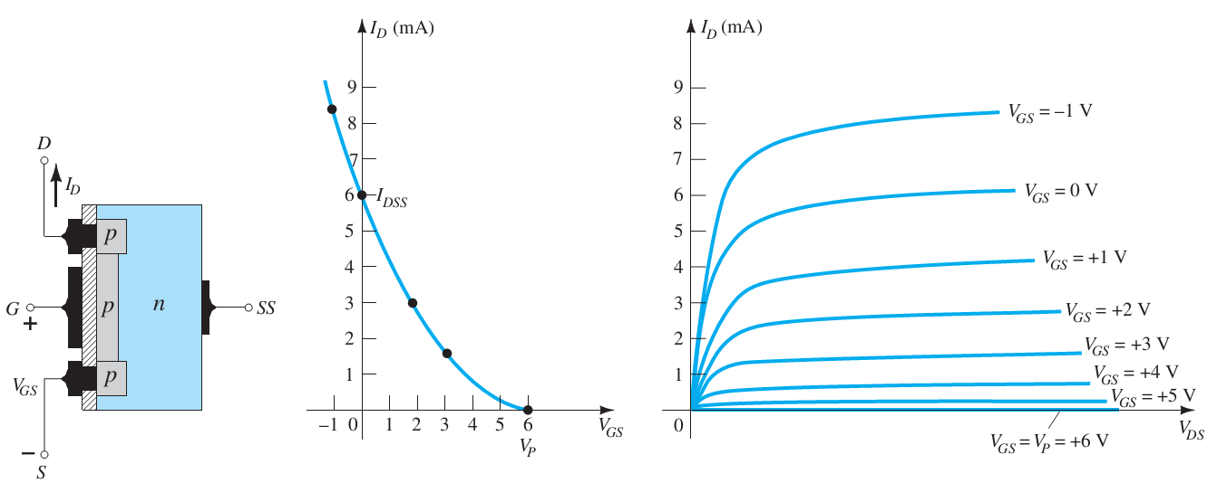
D-MOSFET Operations (P type)

Slide 29
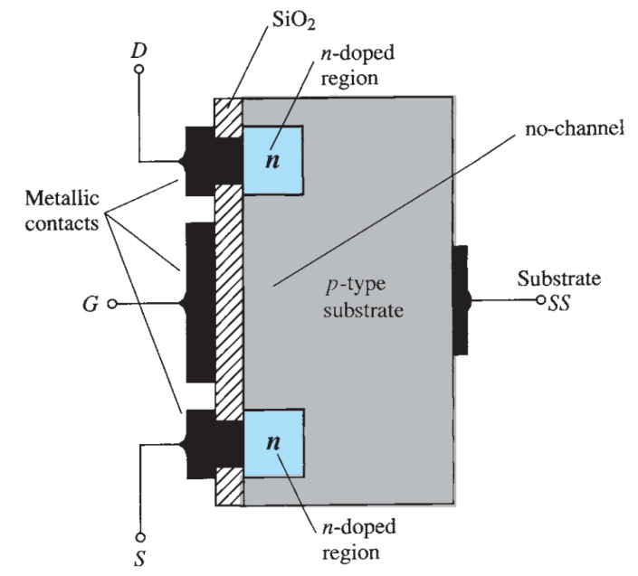
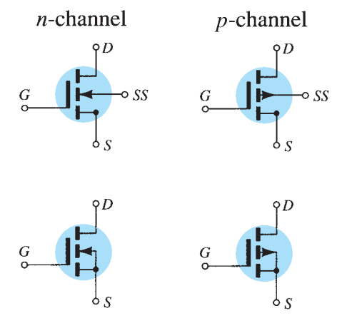
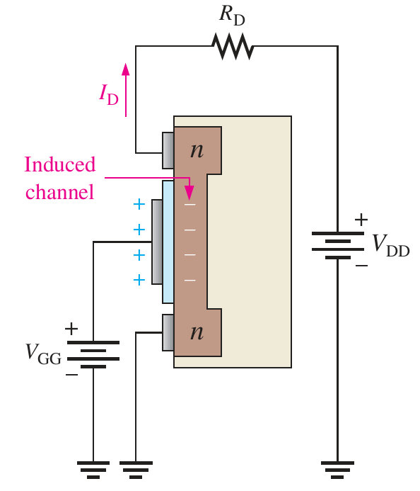
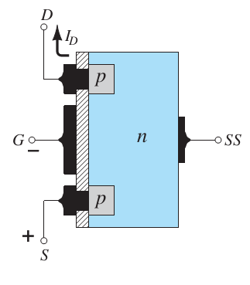
E-MOSFET

Slide 30
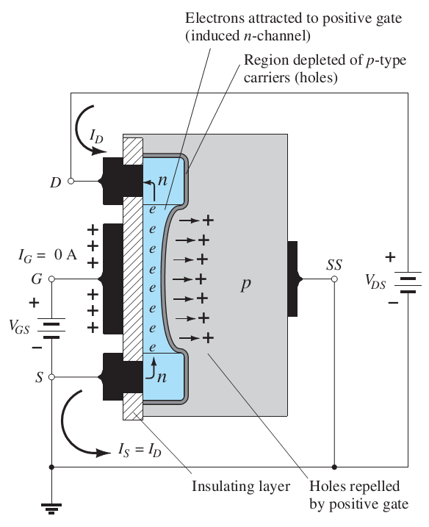
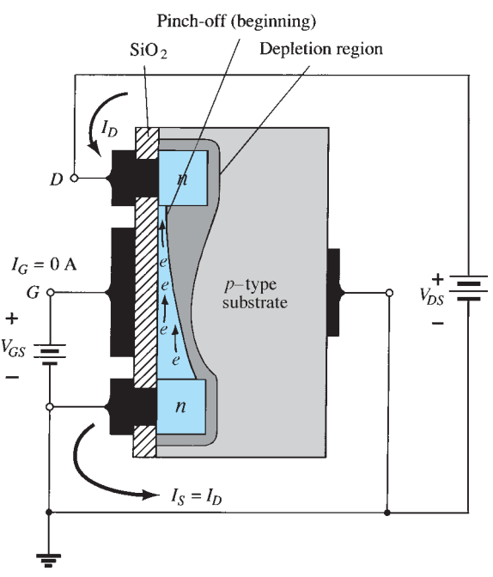
E-MOSFET Operations

Slide 31
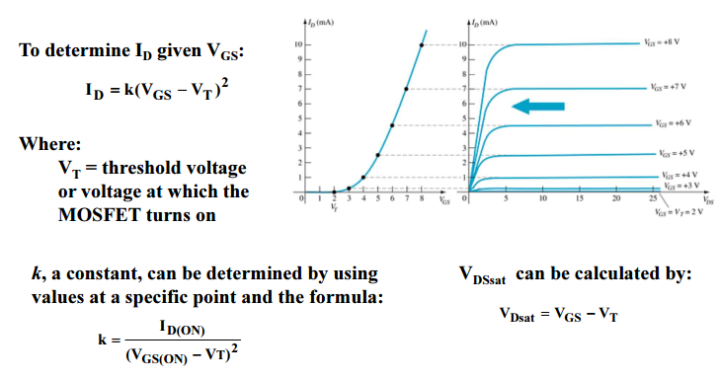
E-MOSFET Transfer Curve

Slide 32
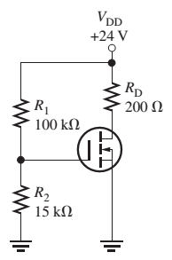
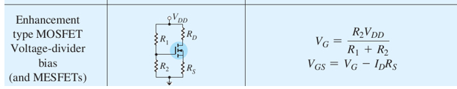
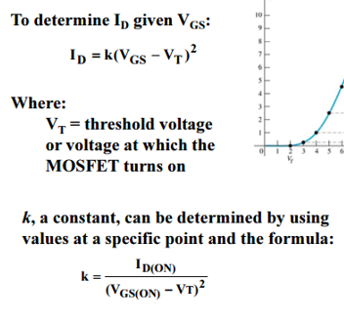
Example
Determine k, I_{D}, V_{GS} and V_{DS} for given E-MOSFET where
V_{GS(on)} = 4V and I_{D(on)} = 200mA
V_{GS(th)} = 2V (=V_{T})
Hint:

Slide 33
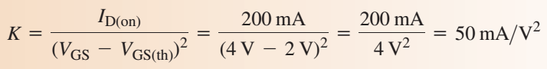


Answer

Slide 34

E-MOSFET Datasheet

Slide 35

JFET Bias

Slide 36


MOSFET Bias

Slide 37

MOSFET Operation Status
MOSFET type | $V_{GS}>0$ | $V_{GS}=0$ | $V_{GS}<0$
N-Channel D-MOSFET | ON | ON | OFF
N-Channel E-MOSFET | ON | OFF | OFF
P-Channel D-MOSFET | OFF | ON | ON
P-Channel E-MOSFET | OFF | OFF | ON

Slide 38

Example
Determine the correct type (p-channel or n-channel, D-type or E-type) of the following MOSFETs

Slide 39

Answer

Slide 40

Reference

